Slide 1
NAME: KASAGONI JAGRUTHI YEAR:3rd YEAR
COLLEGE:JNTUHCEJ
BRANCH:CSE
PROJECTNAME :applying classifier/ regression, Exploratory Data Analysis
MAJOR PROJECT 1 and 2

Slide 2
MAJOR PROJECT-1 URL-https://colab.research.google.com/drive/14TZ3IACj36RO5d4KGtup5r67MaeA00VM#scrollTo=5UTKdkG_latr

Slide 3
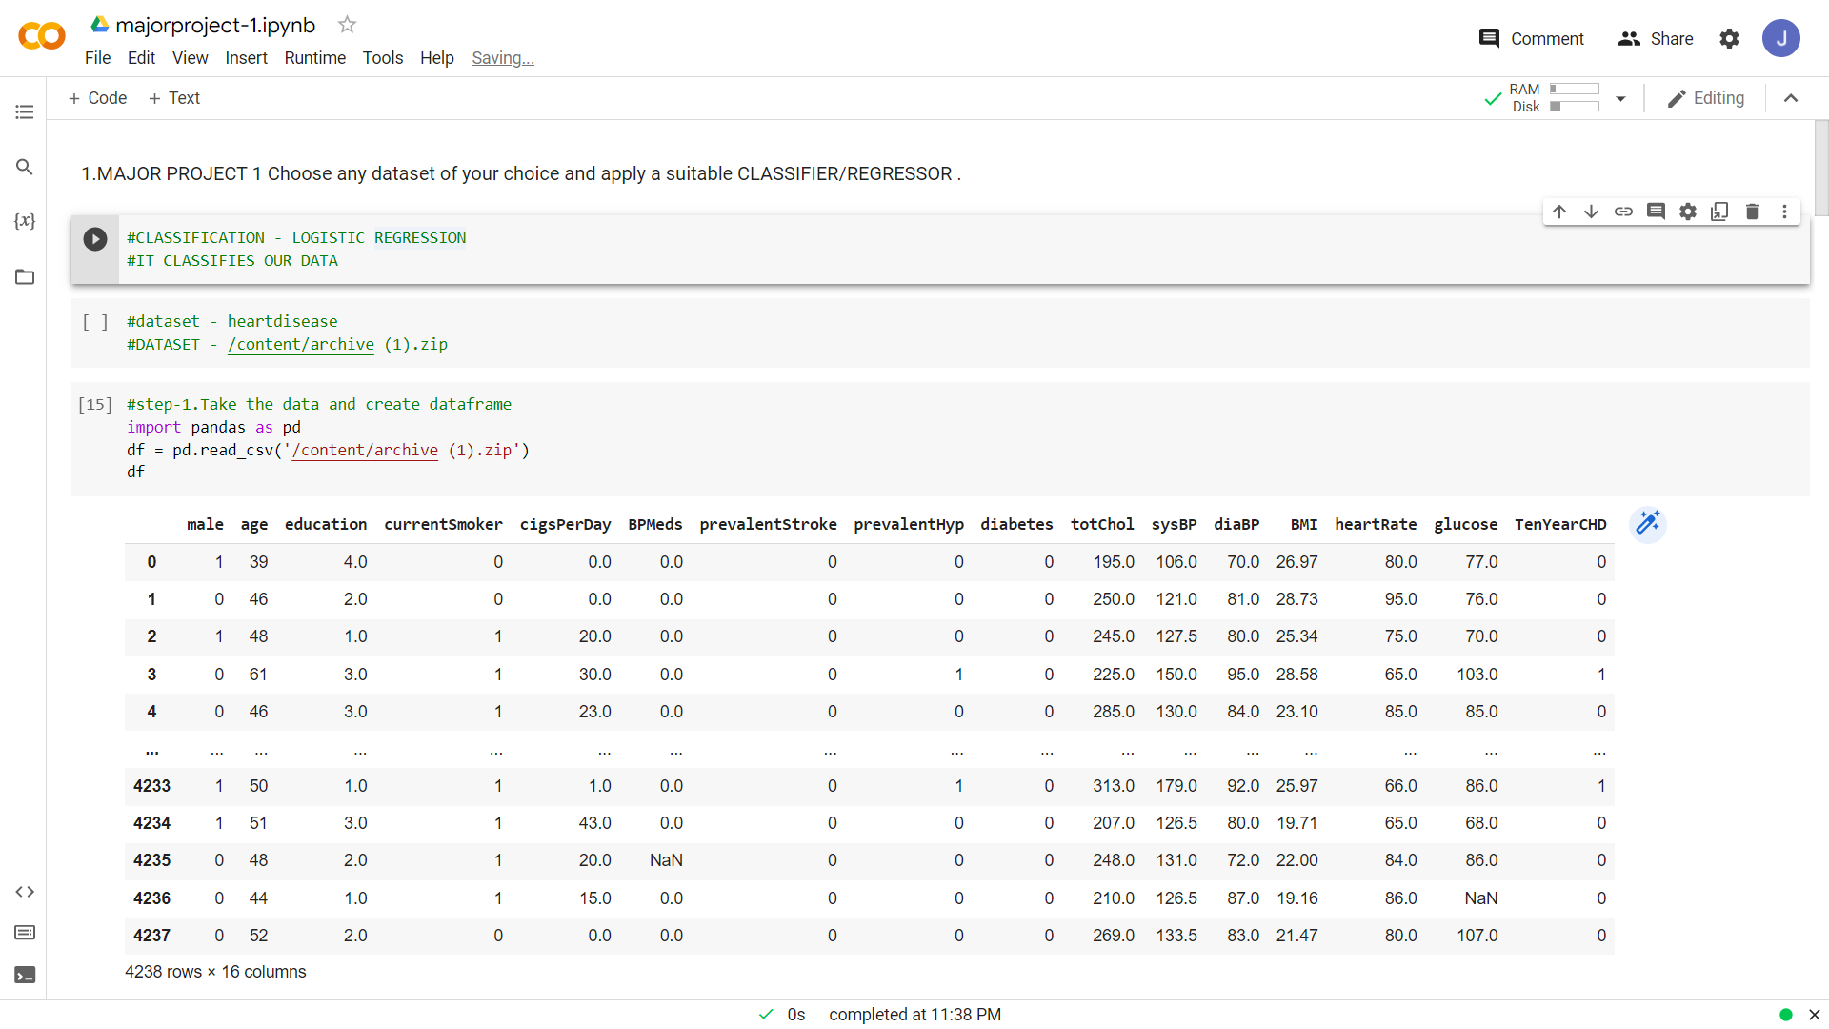

Slide 4
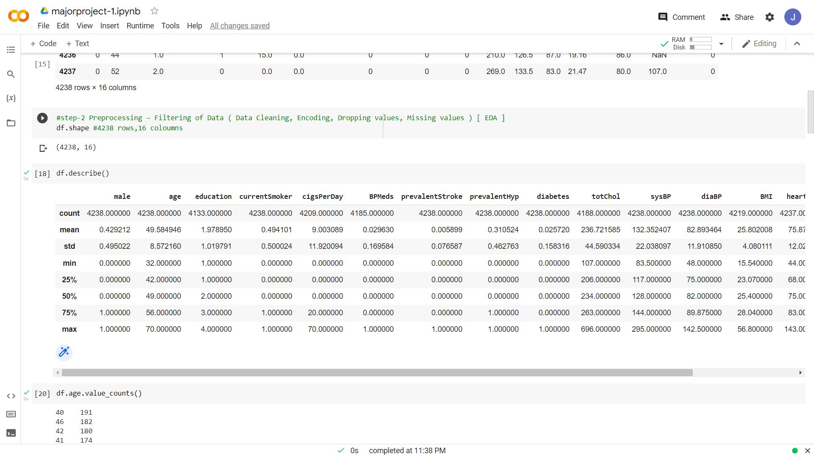

Slide 5
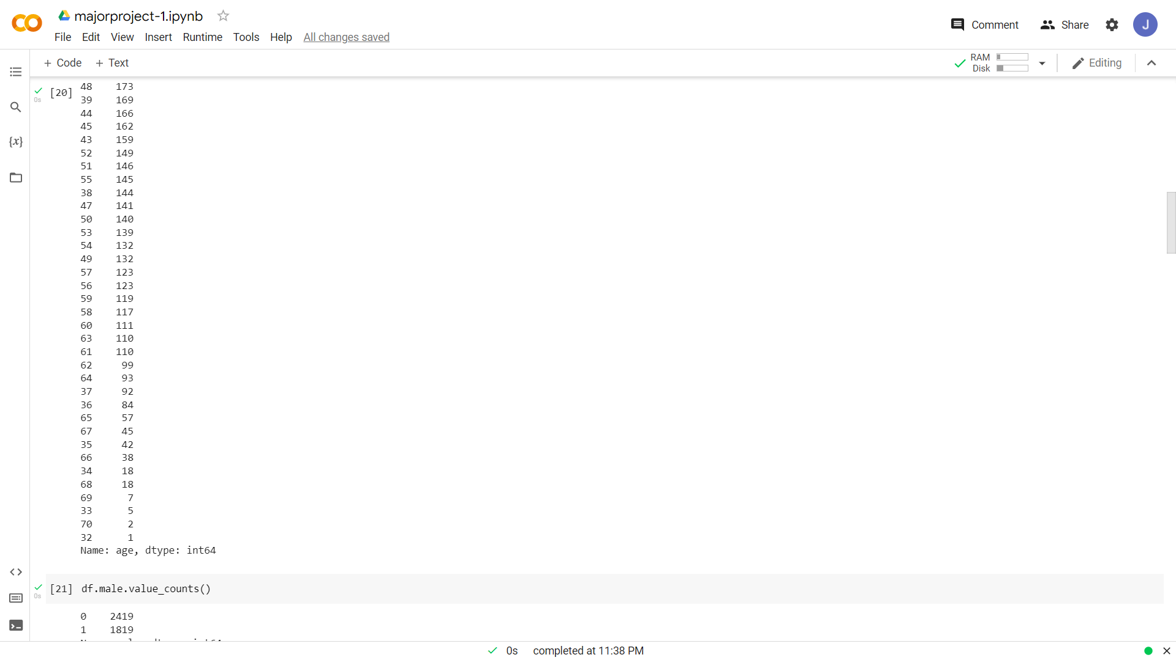

Slide 6
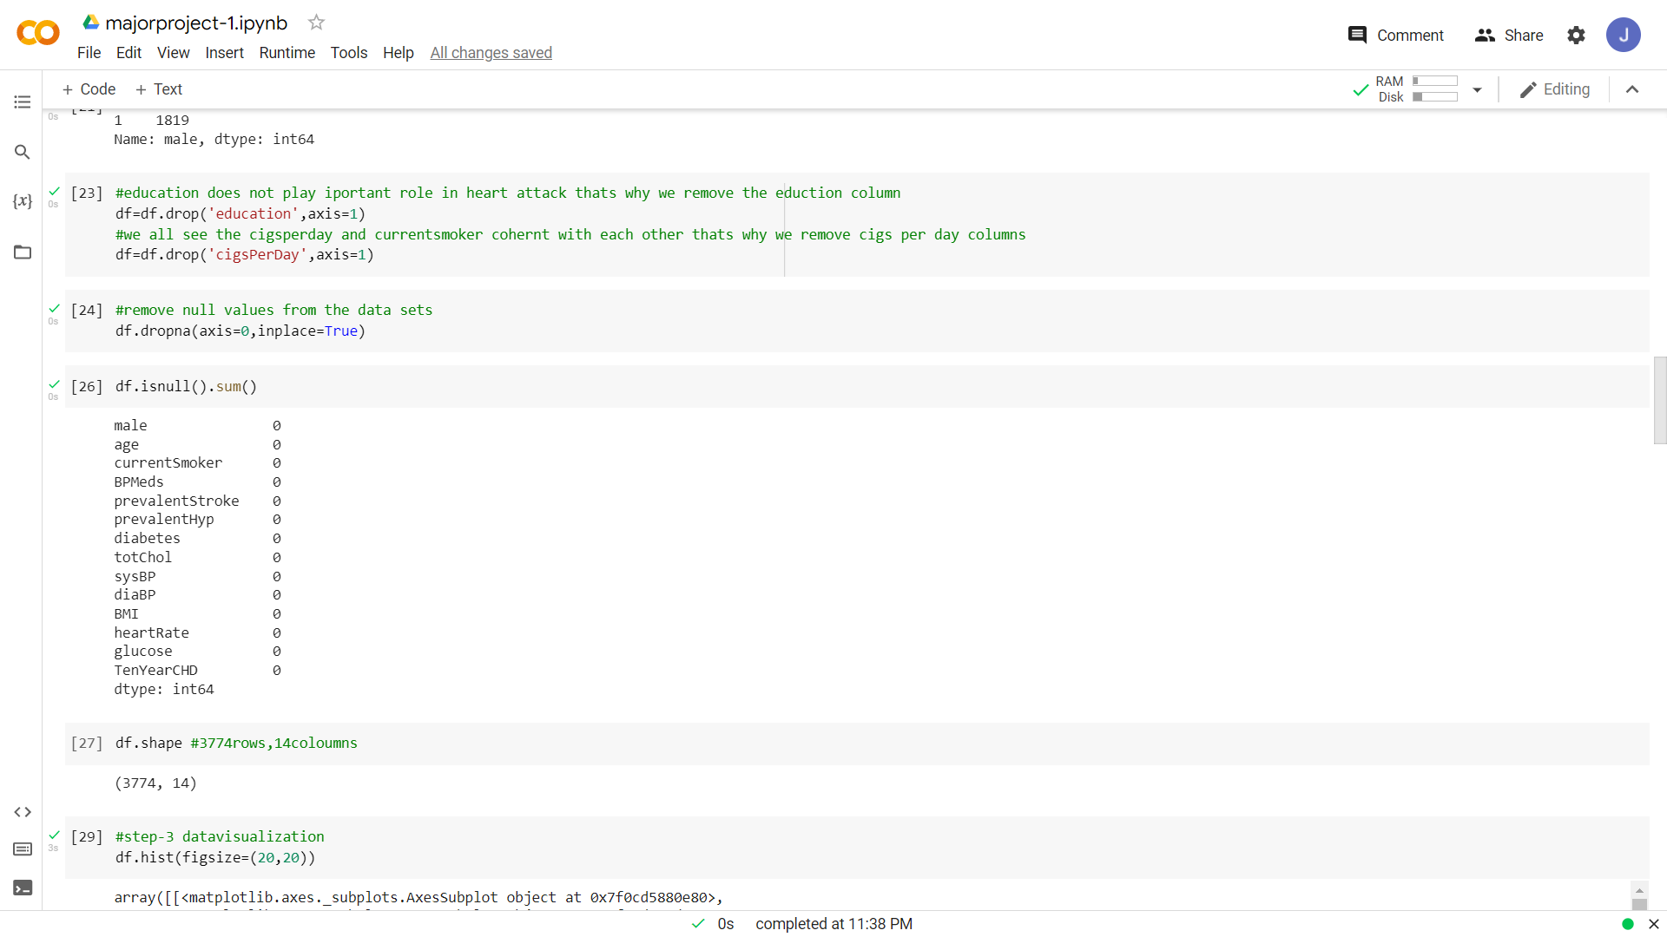

Slide 7
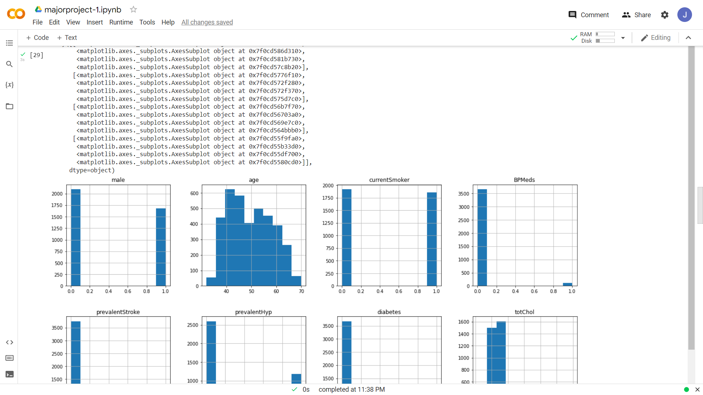

Slide 8
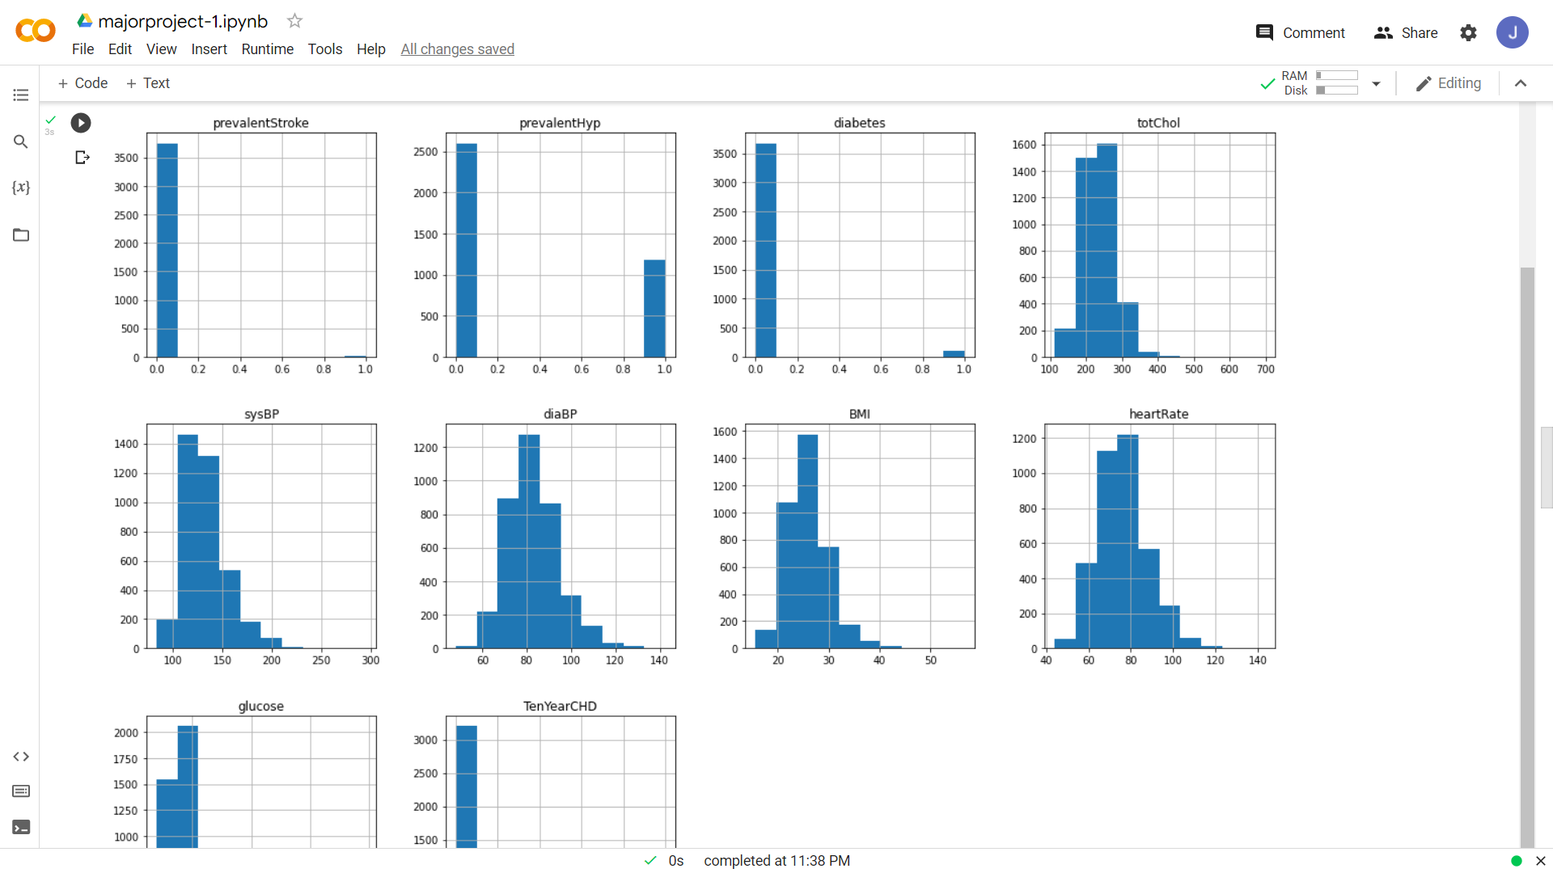

Slide 9
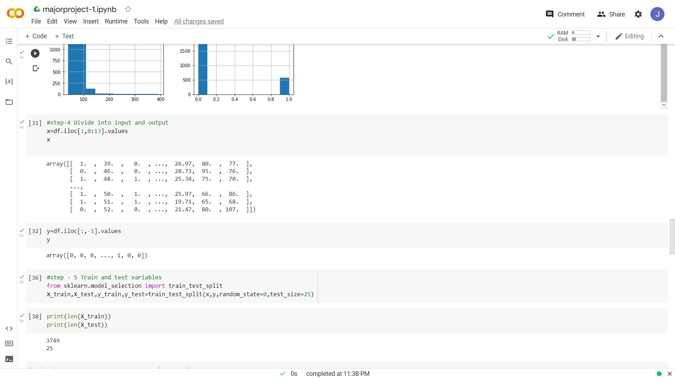

Slide 10
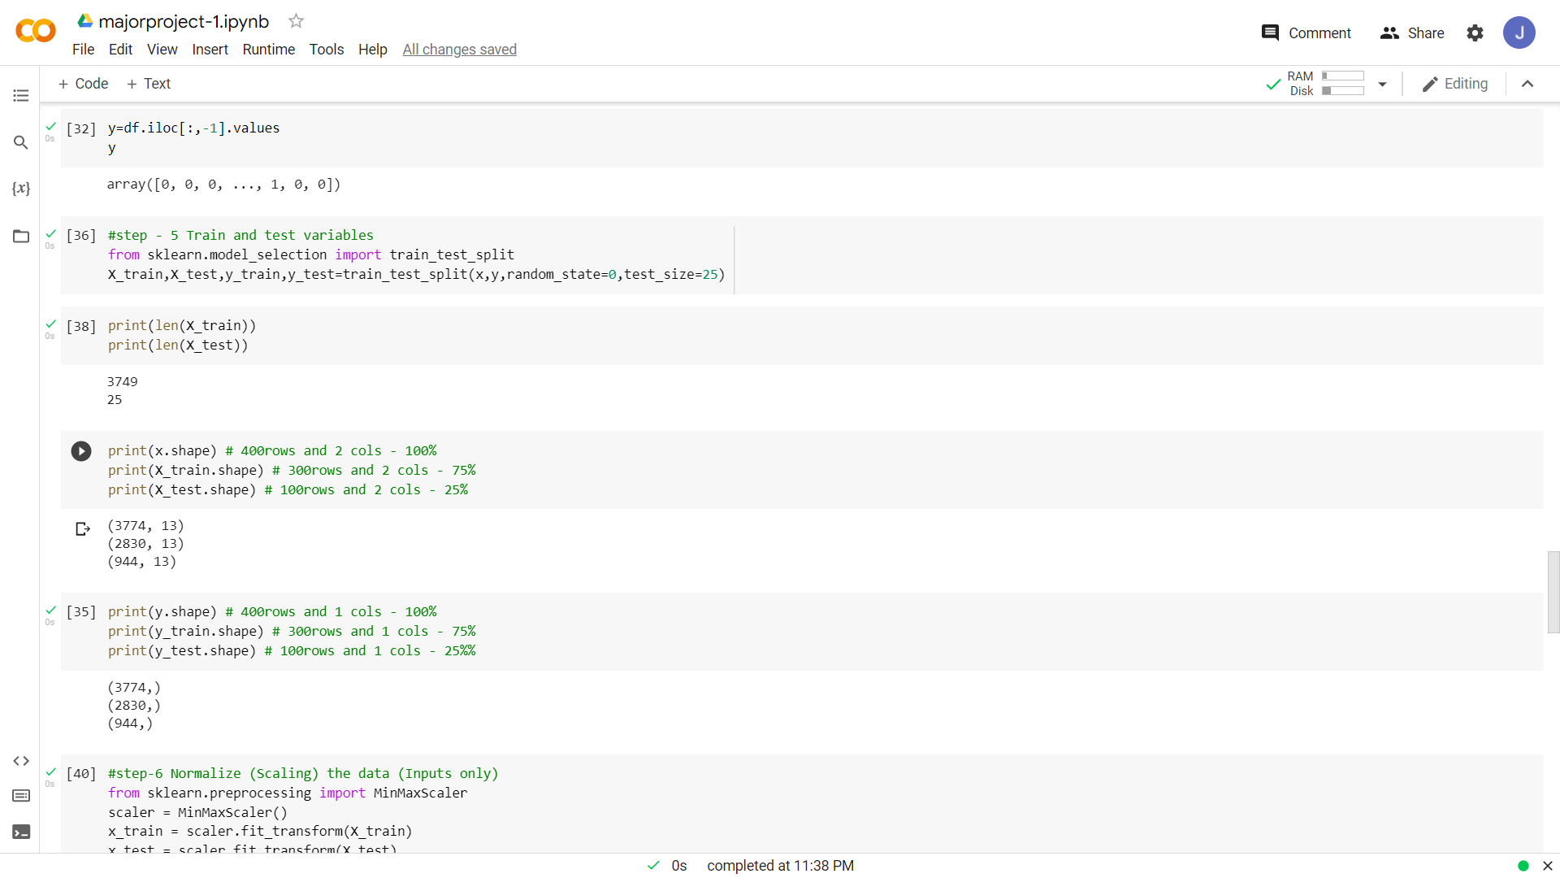

Slide 11
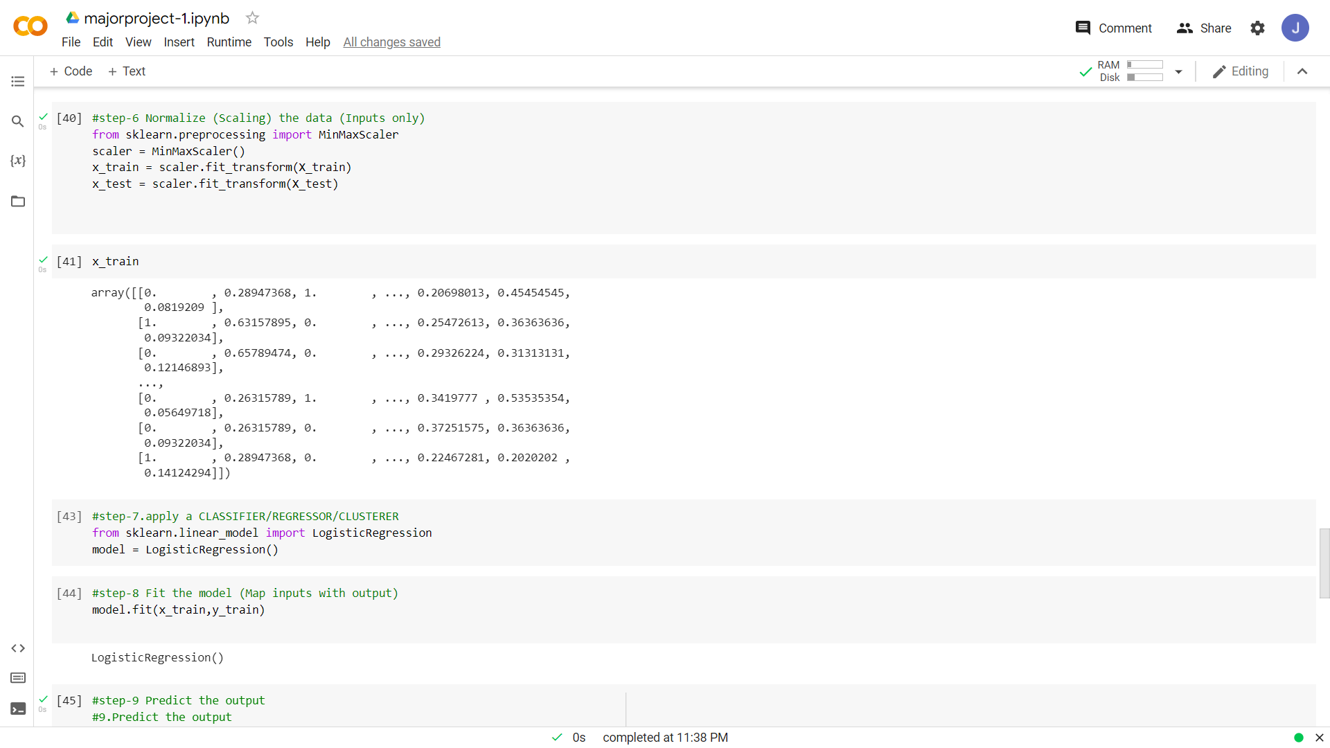

Slide 12
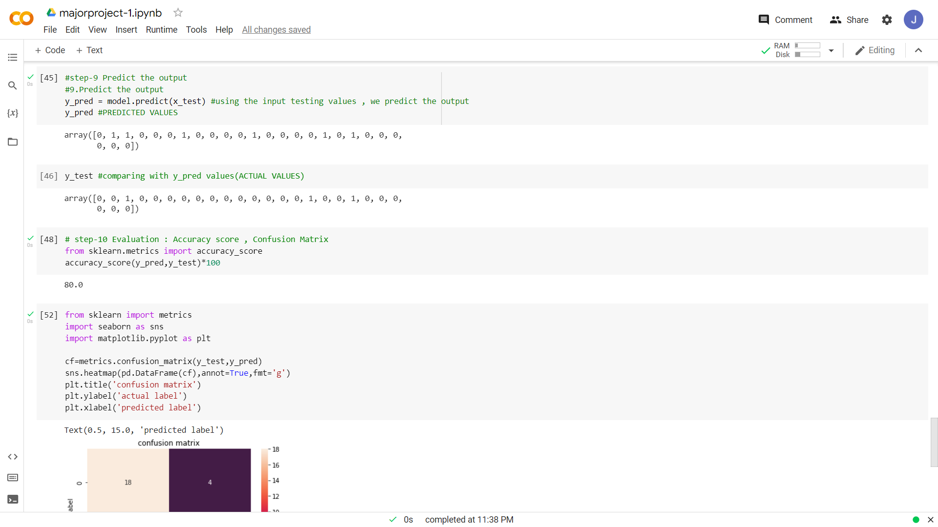

Slide 13
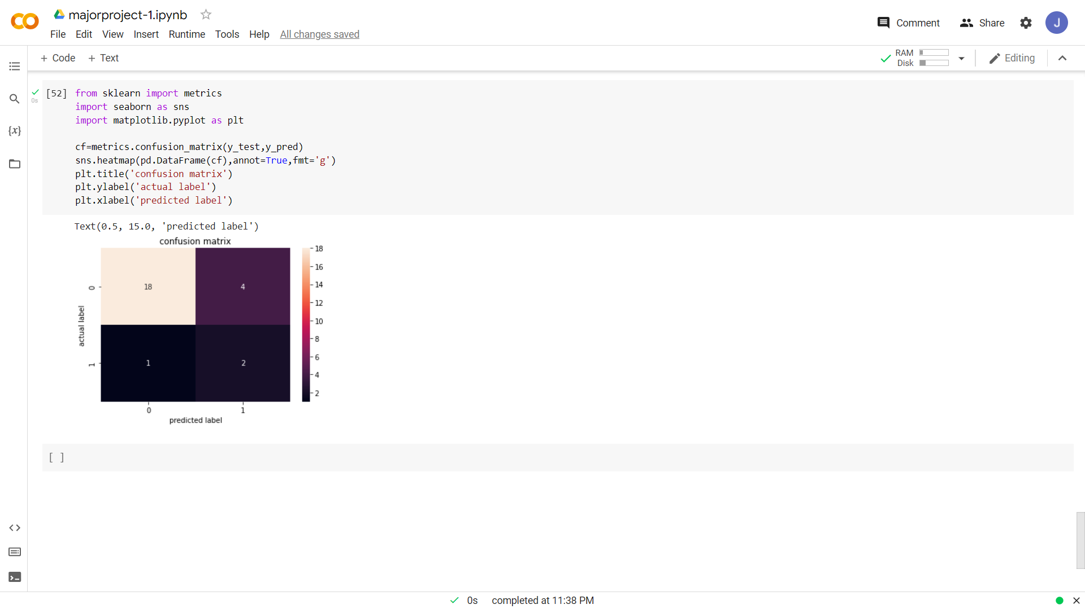

Slide 14
MAJOR PROJECT-2
URL-https://colab.research.google.com/drive/1foFEvmgo26iYbh0BapRjPJm0rXlPfD39

Slide 15
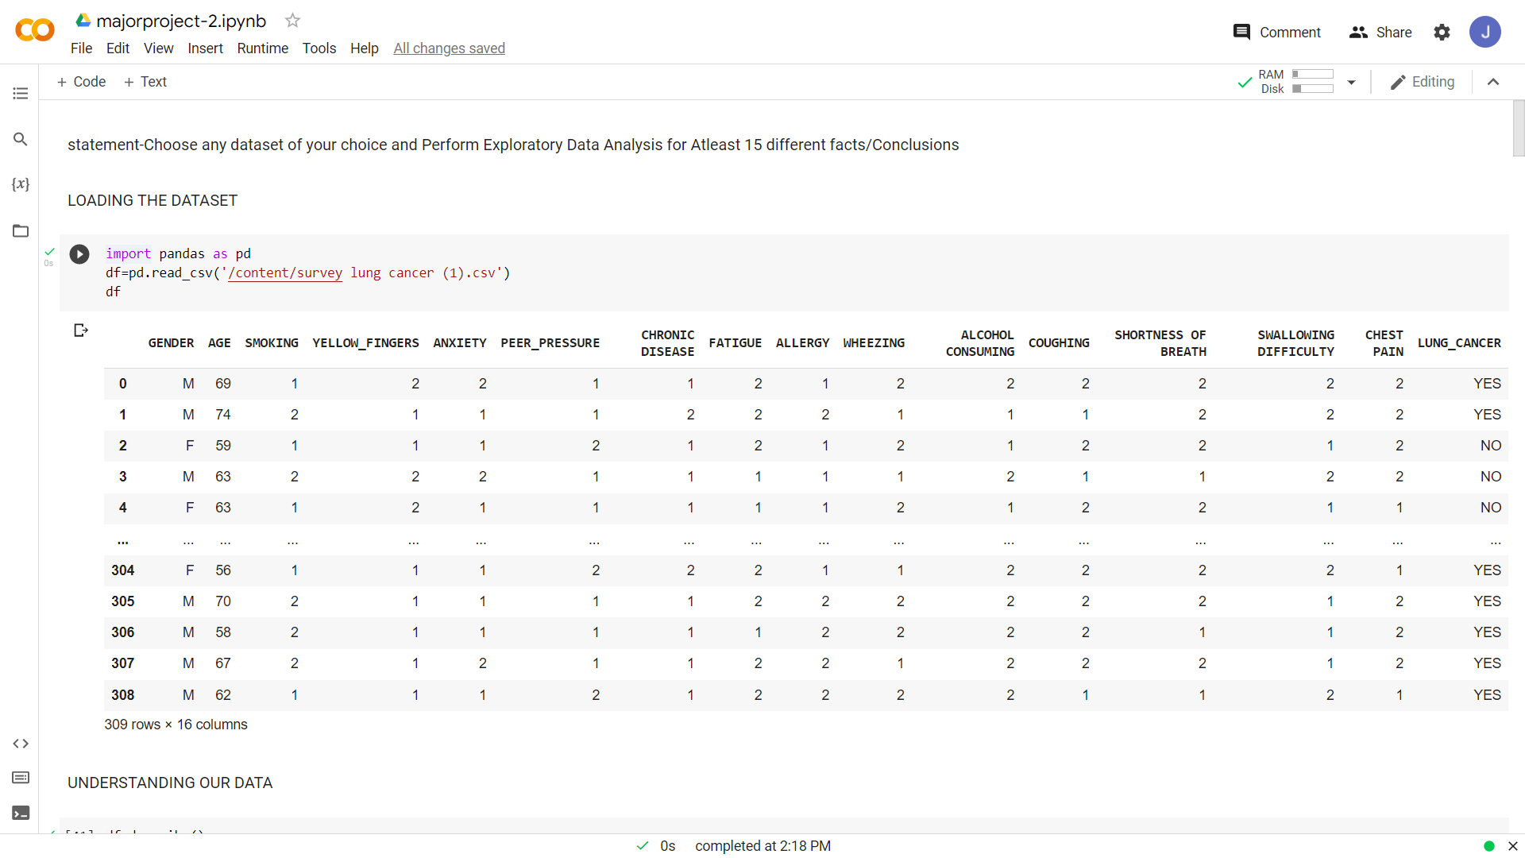

Slide 16
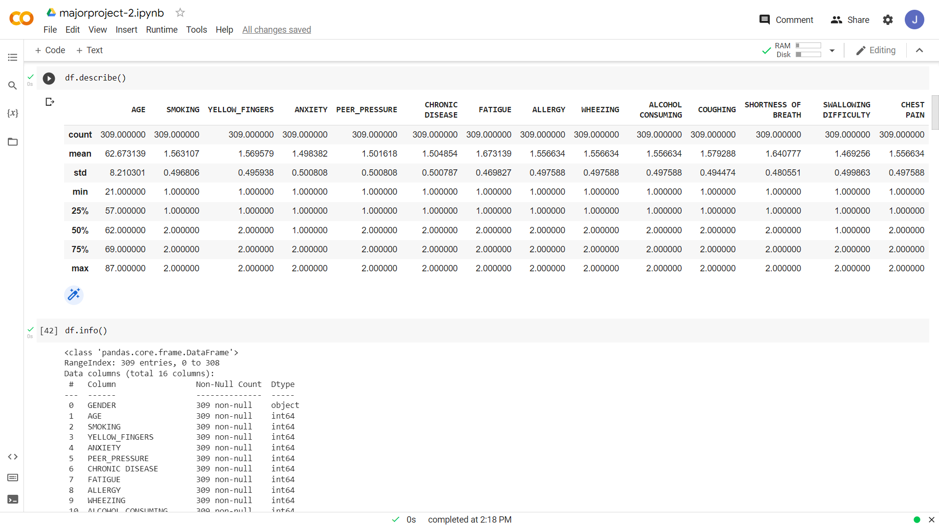

Slide 17
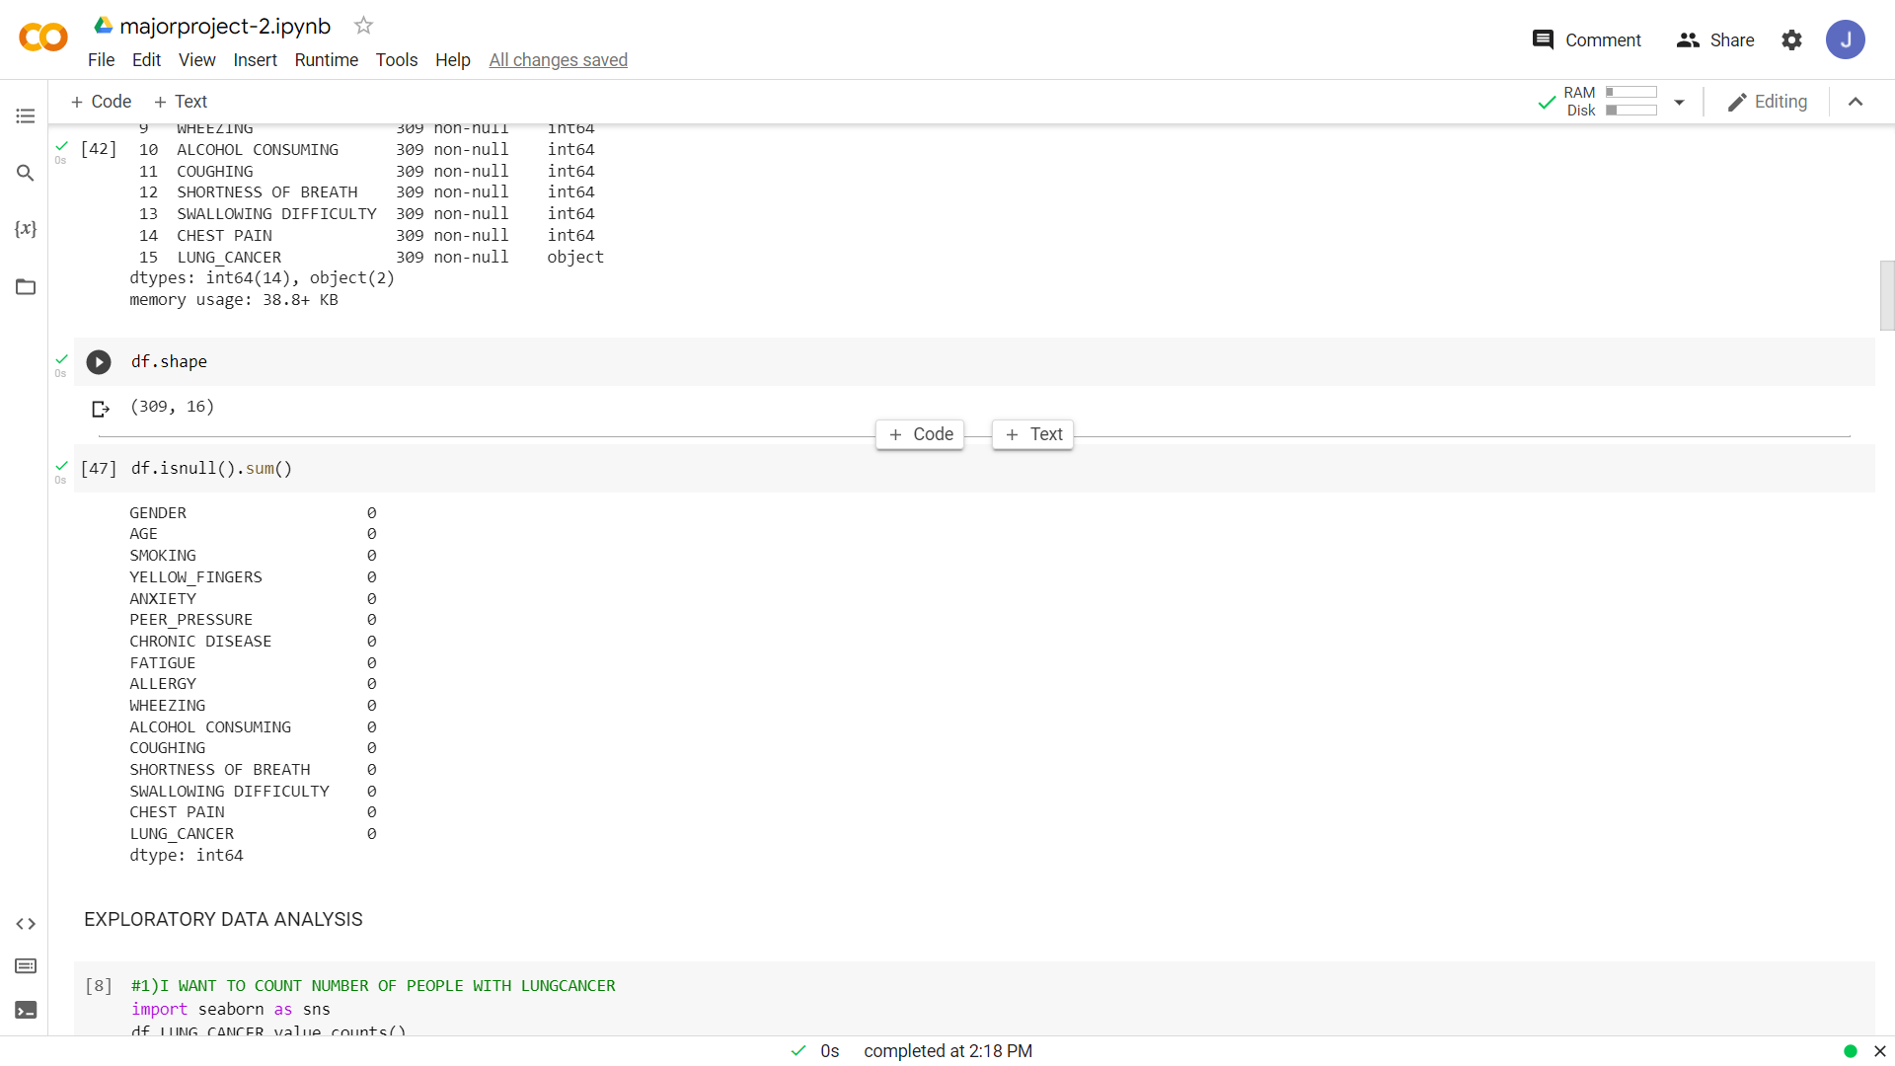

Slide 18
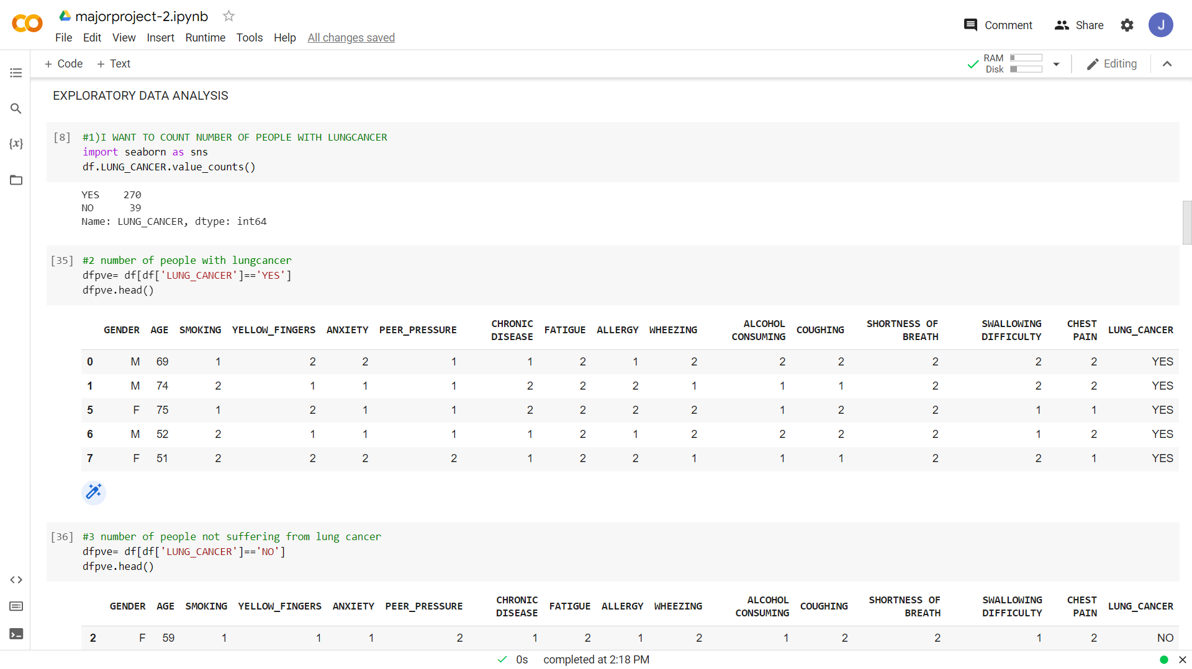

Slide 19
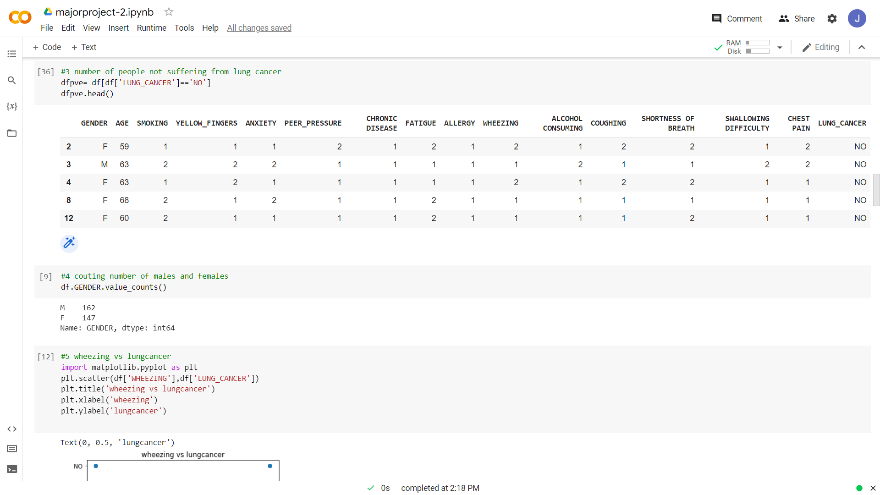

Slide 20
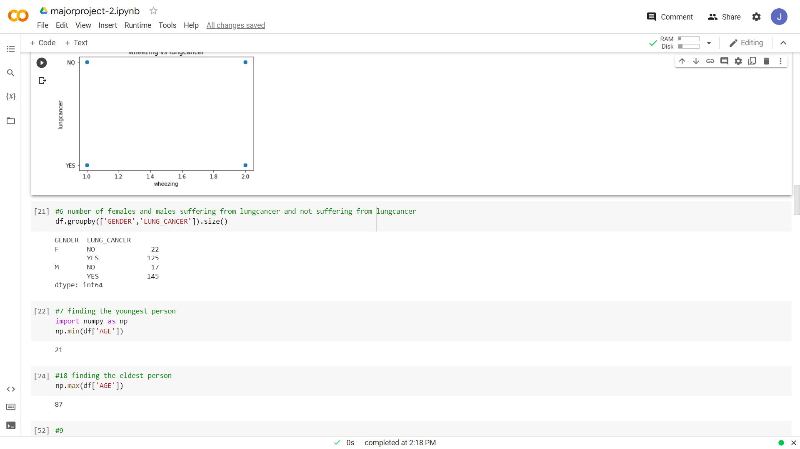

Slide 21
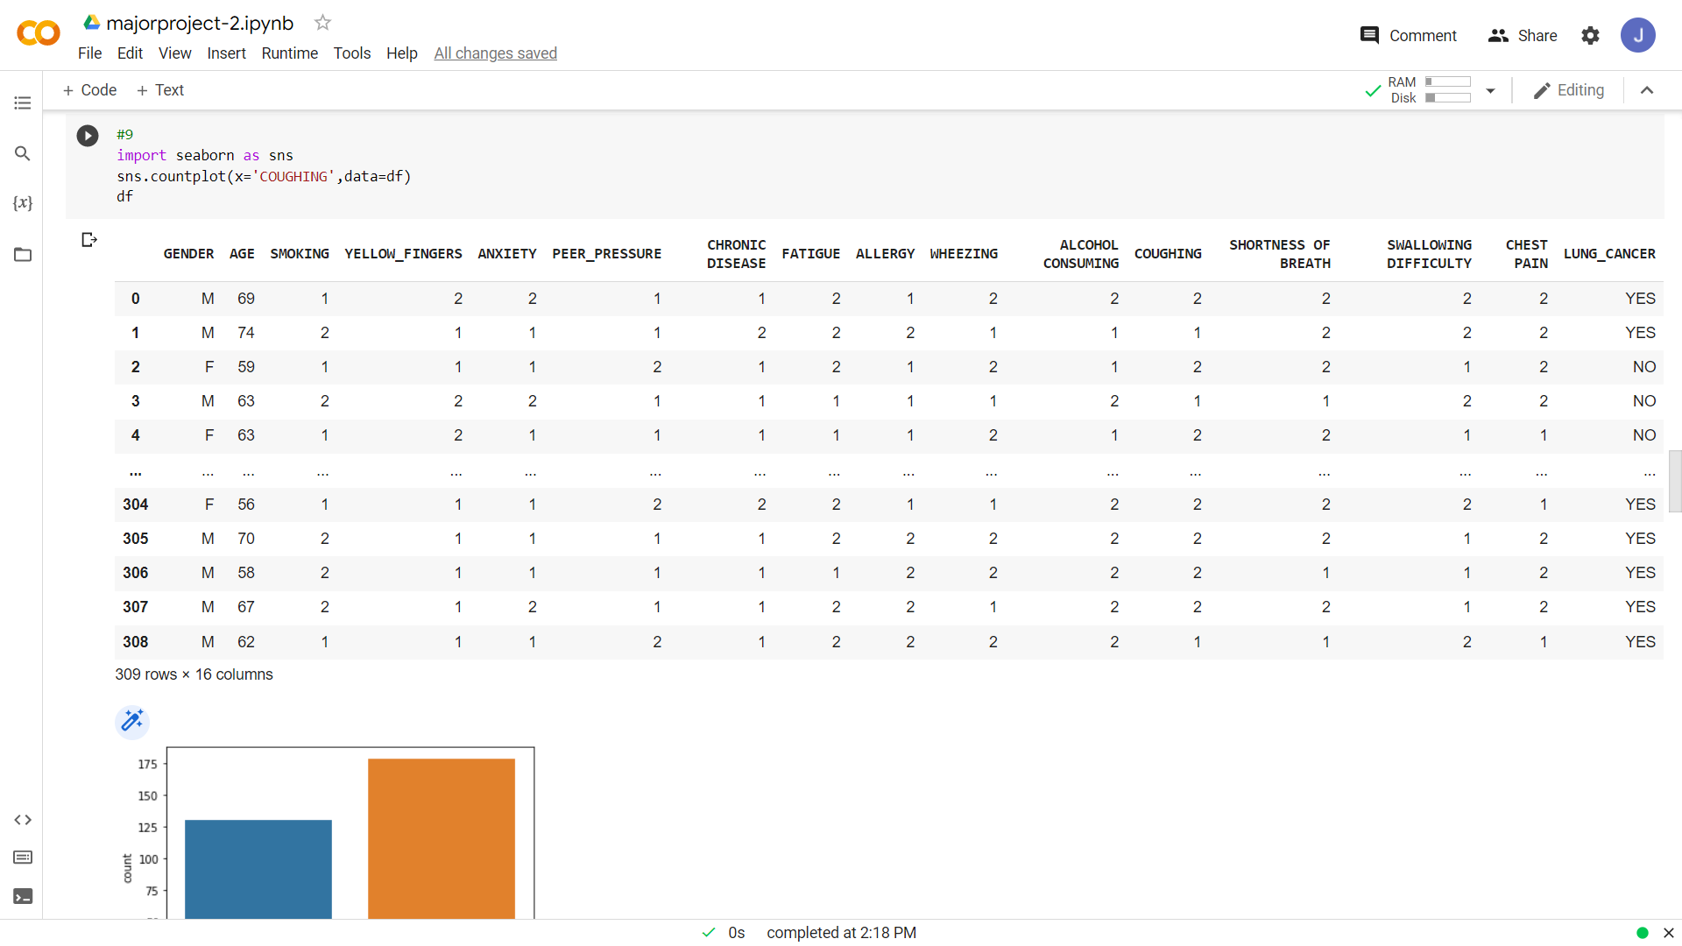

Slide 22
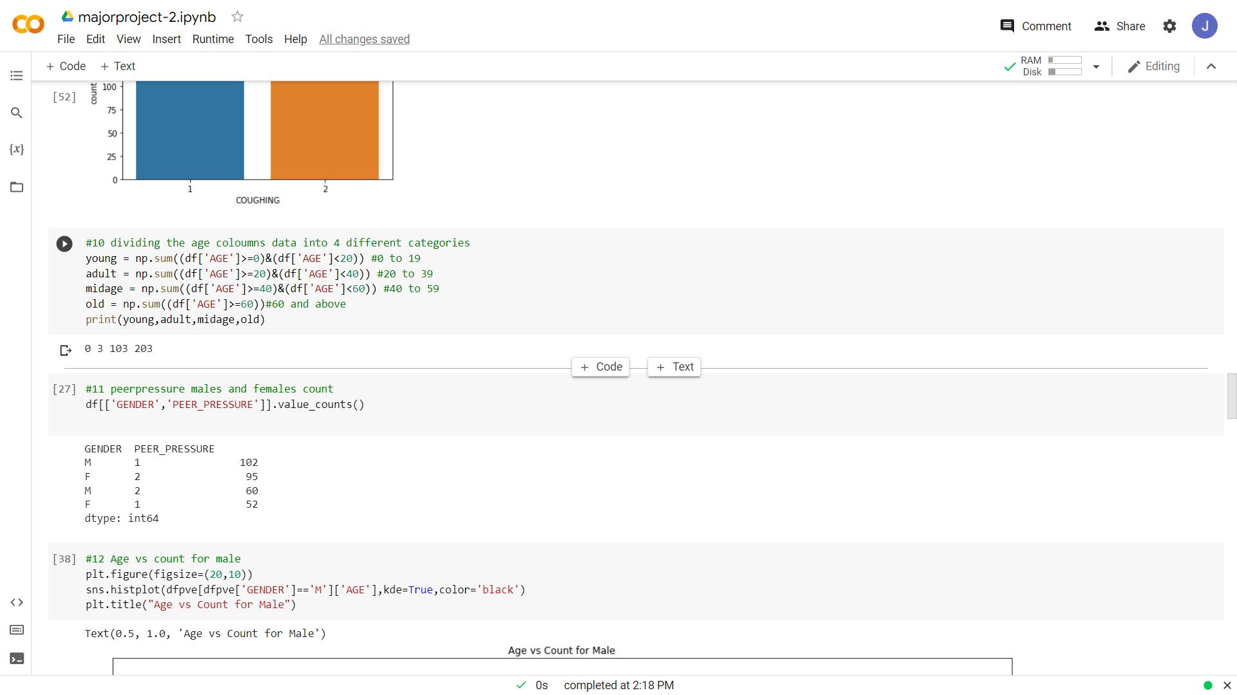

Slide 23
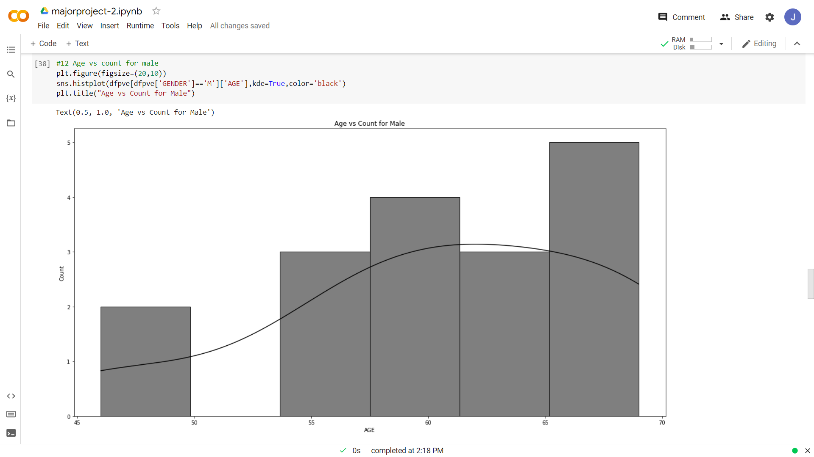

Slide 24
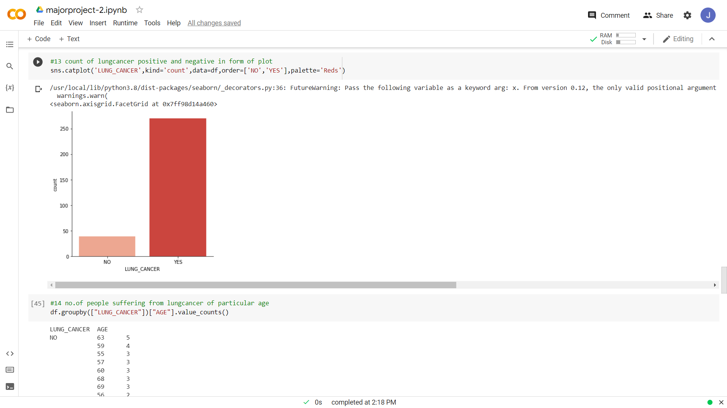

Slide 25
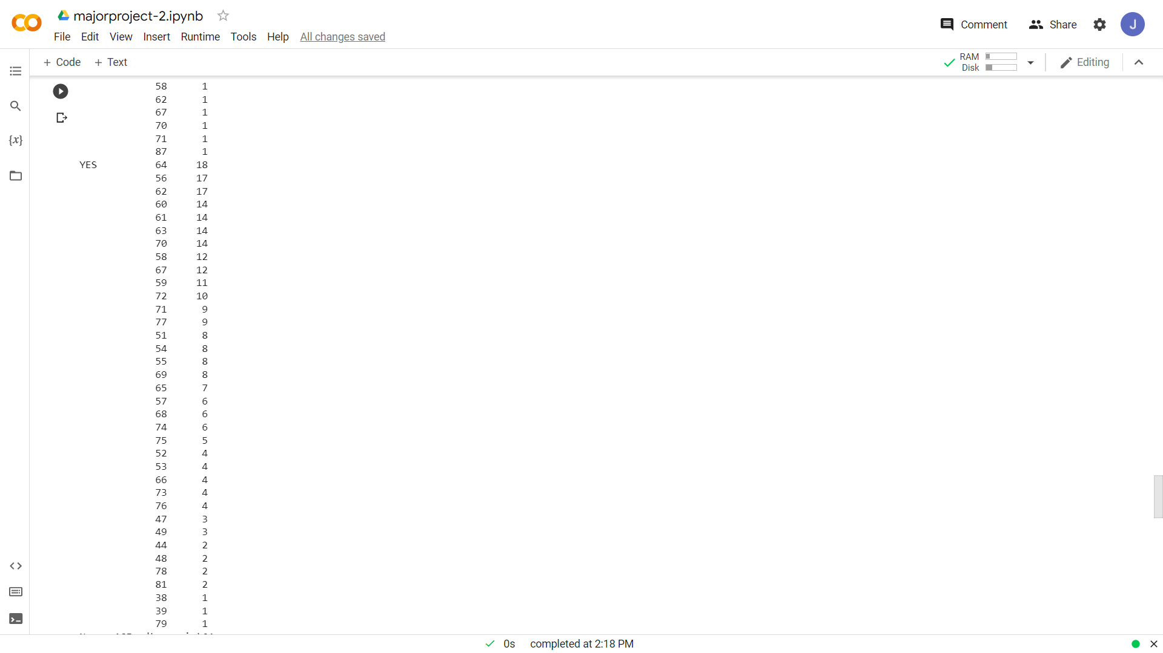

Slide 26
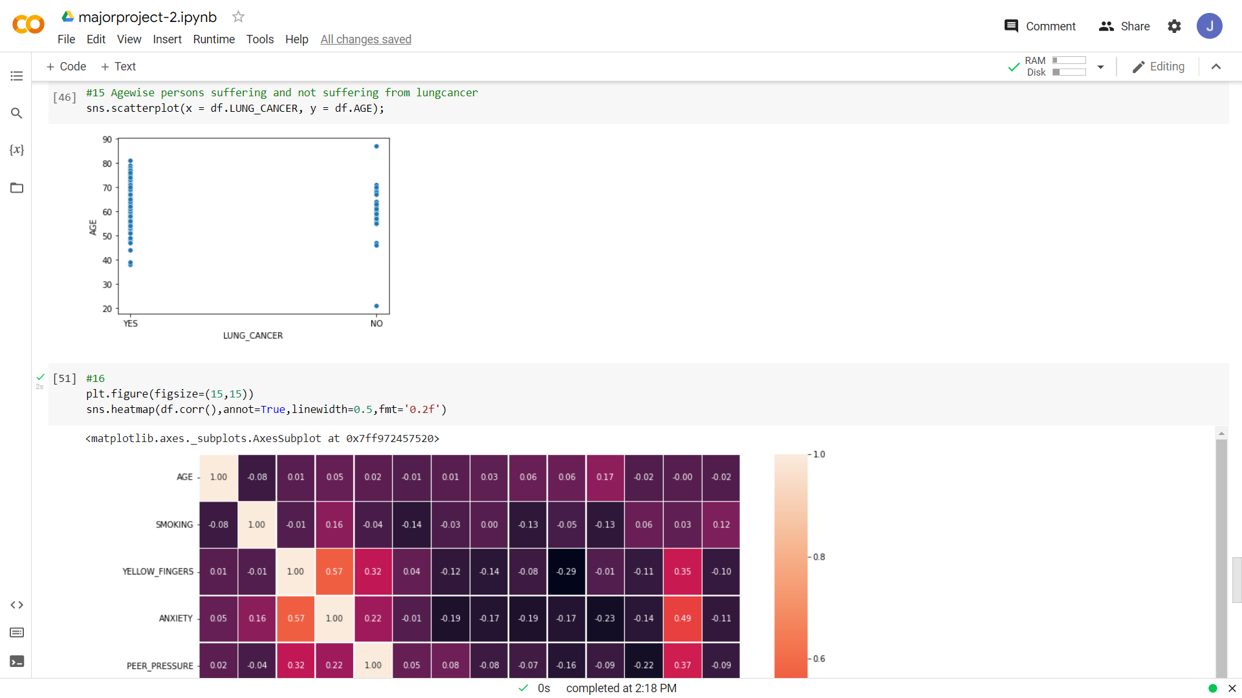

Slide 27
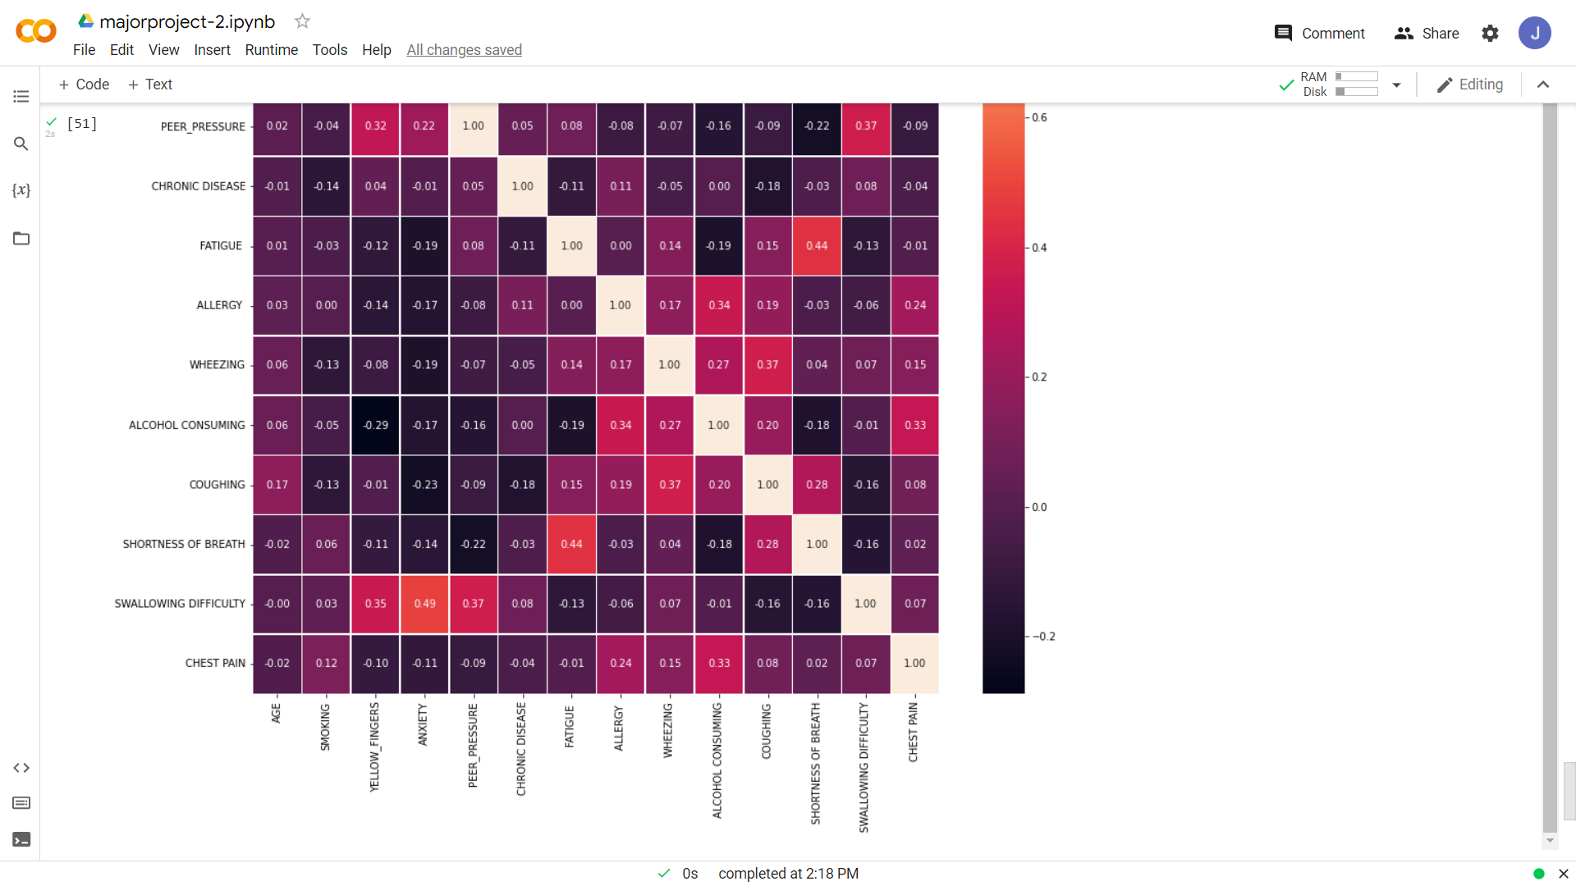

Slide 28
github account: https://github.com/KasagoniJagruthi2108

